Slide 1
Assignment-Discussion POS Tagging Using HMM
P Sai Aditya, 200050111
Yash Mailapalli, 200050160
Yashvardhan, 200050162
4th September,2022

Slide 2
Problem Statement
Given a sequence of words, produce the POS tag sequence
Technique to be used: HMM-Viterbi
Use Universal Tag Set (12 in number)
5-fold cross validation
'.', 'ADJ', 'ADP', 'ADV', 'CONJ', 'DET', 'NOUN', 'NUM', 'PRON', 'PRT', 'VERB', 'X'

Slide 3
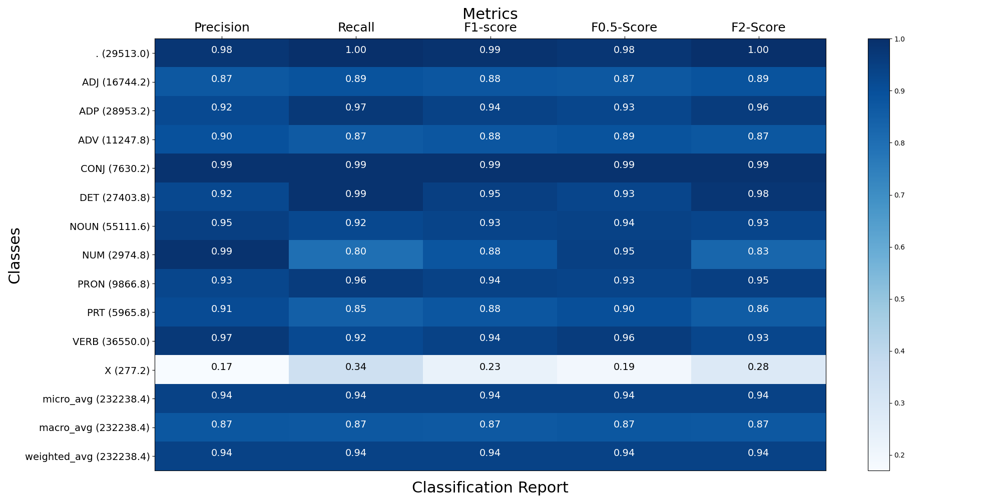
Overall performance

Slide 4
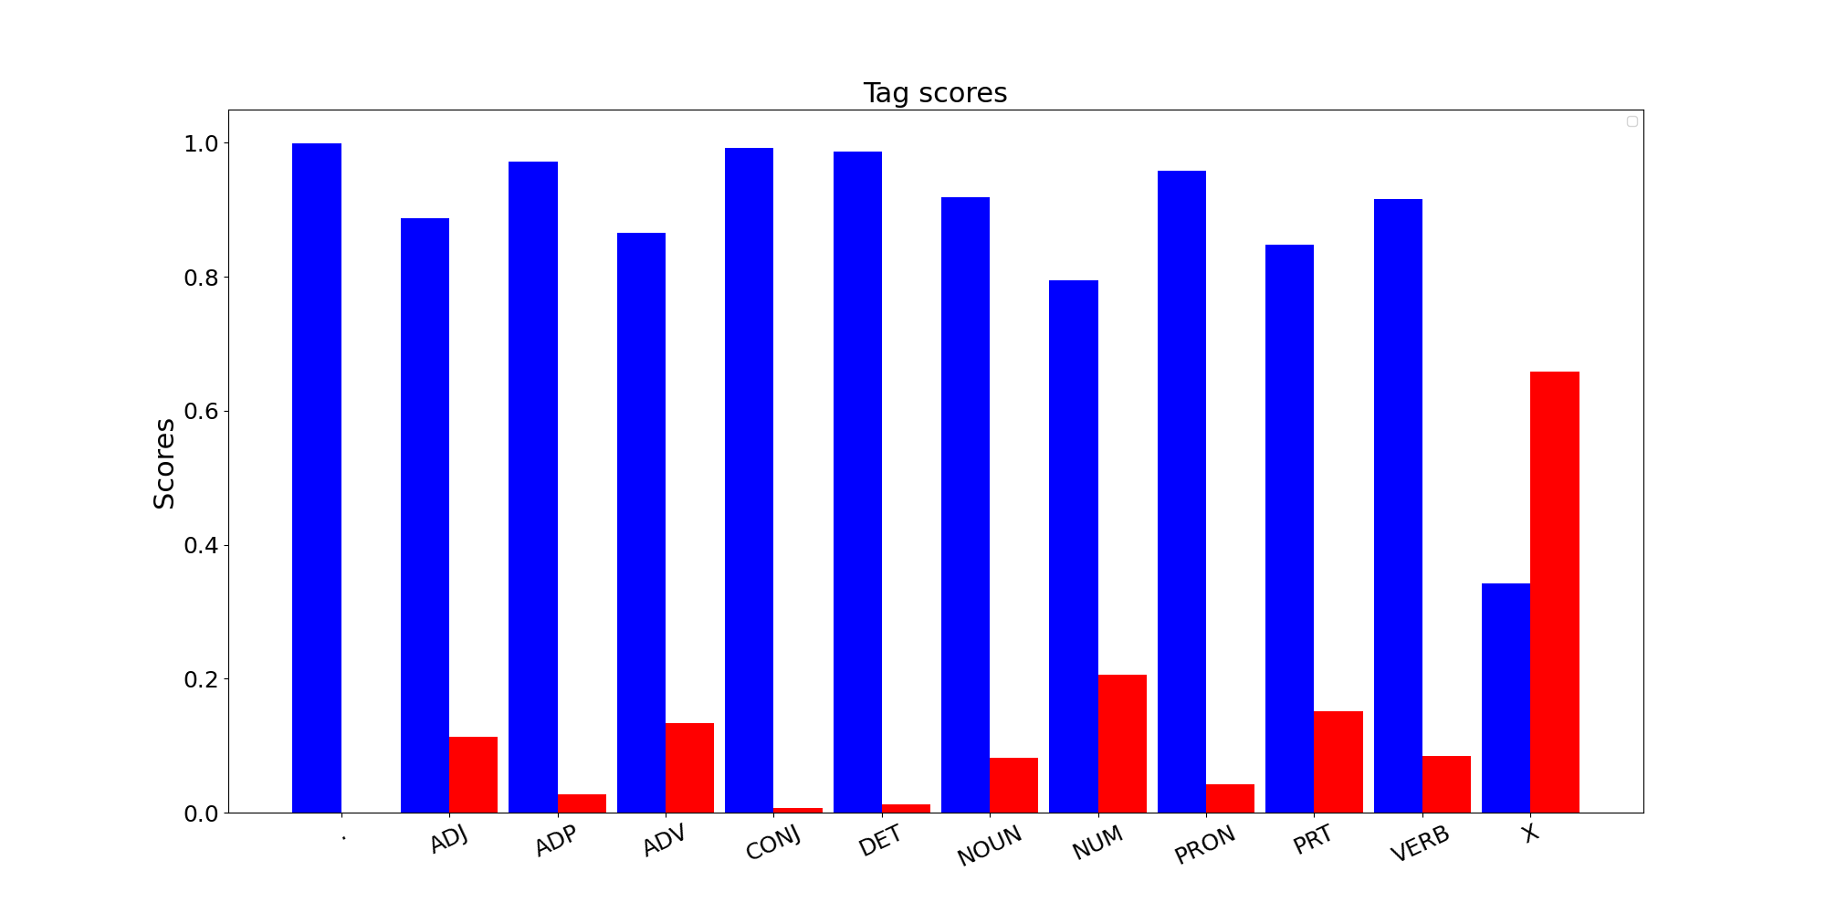
Per POS performance

Slide 5
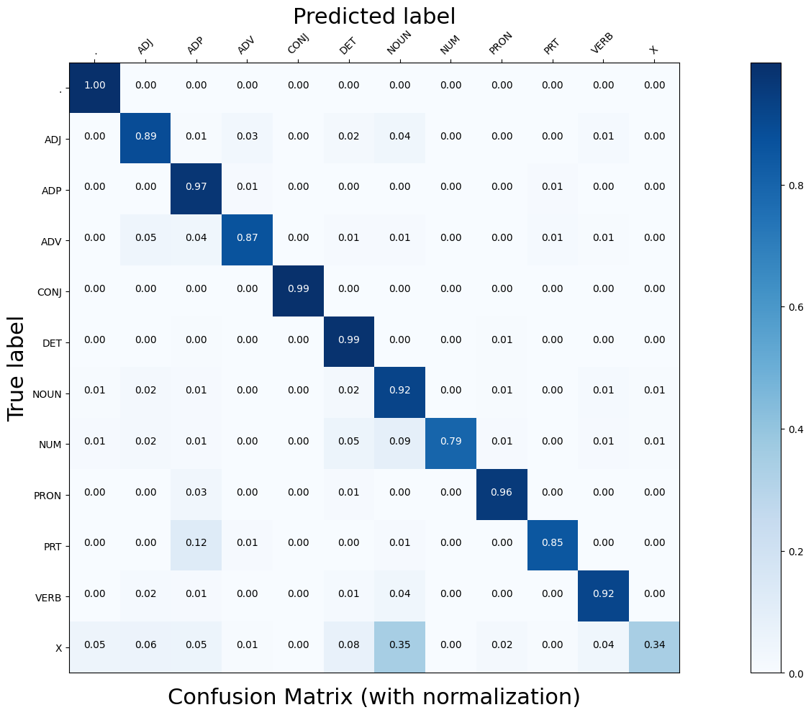
Confusion Matrix (12 X 12)

Slide 6
Interpretation of confusion (error analysis)
Tag ‘X’, i.e foreign words is mostly confused with Tag ‘Noun’.
Intuitively we can see that due to restricted amount of data and tags, many (proper) nouns may not be found in training data.
Due to this while training probability of Word being noun can tend to zero, word (noun) may be falsely classified as tag ‘X’

Slide 7
Data Processing Info (Pre-processing)
Transition probabilities were created using python defaultdict.
We iterated over all the tags to determine the number of occurrence of Tj followed Ti and Word (w) given tag T respectively
Probability functions were defined for transition and lexical probability taking corner cases into account.
Problem faced were:
Lower Casing: same word were treated differently based on capital letter
Unknown Word(w): in this case Prob(w|tag) is zero and was dealt separately.
No case of transition from state T1 to T2
Underflow of probability was taken care by using log probability

Slide 8
Inferencing/Decoding Info
Viterbi is a Dynamic Programming algorithm used determining the sequence of states.
Given Markov assumption, the current state only depend on the previous state.
We iterated over index of the given sentence and calculated probability of the some tag T at given index for given word over all the previous tags(states) pT.
P(O|Si) and P(Si|Si-1) were calculated form above mentioned function
We also stored bptr to the previous tag for every tag in the list.
At the end of the iteration we determine the path or the last tag having maximum probability, based on which and bptr array we return the predicted tag for sentence

Slide 9
Marking Scheme
1. Demo working- 10/10 (if not, 0)
2. Implemented Viterbi and Clarity on Viterbi- 5/5
3. Transition and Lexical tables clearly described- 5/5
4. Confusion matrix drawn and error analysed- 5/5
5. Overall F-score > 90- 10/10, >80 & <=90- 8/10, else 6/10
6. Unknown word handling- done (5/5; else 0)

Slide 10
Any thoughts on generative vs. discriminative POS tagging
In general, a discriminative model ‌models the decision boundary between the classes, and a generative model ‌explicitly models the actual distribution of each class.
A generative model ‌learns the joint probability distribution 𝑝(𝑥,𝑦). It predicts the conditional probability with the help of the Bayes Theorem. A discriminative model ‌learns the conditional probability distribution 𝑝(𝑦|𝑥).

